Slide 1


Testing
Chapter 2
SOFTWARE ENGINEERING

Slide 2
Testing Concepts
Testing – the process of examining a component, subsystem, or system to determine its operational characteristics and whether it contains any defects
Test case – a formal description of a starting state, one or more events to which the software must respond, and the expected response or ending state
Defined based on well understood functional and non-functional requirements
Must test all normal and exception situations
Test data – a set of starting states and events used to test a module, group of modules, or entire system
The data that will be used for a test case

Slide 3
Most common types of tests
Test type | Core process | Need and purpose
Unit testing | Implementation | Software components must perform to the defined requirements and specifications when tested in isolation – for example, a component that incorrectly calculates sales tax amounts in different locations is unacceptable.
Integration testing | Implementation | Software components that perform correctly in isolation must also perform correctly when executed in combination with other components. They must communicate correctly with other components in the system. For example a sales tax component that calculates incorrectly when receiving money amounts in foreign currencies is unacceptable.
System and stress testing | Deployment | A system or subsystem must meet both functional and non-functional requirements. For example an item lookup function in a Sales subsystems retrieves data within 2 seconds when running in isolation, but requires 30 seconds when running within the complete system with a live database.
User acceptance testing | Deployment | Software must not only operate correctly. but must also satisfy the business need and meet all user “ease of use” and “completeness” requirements-for example, a commission system that fails to handle special promotions or a data-entry function with a poorly designed sequence of forms is unacceptable.

Slide 4
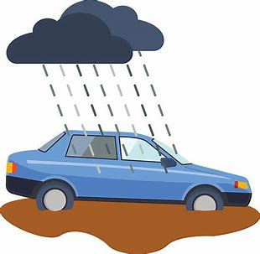
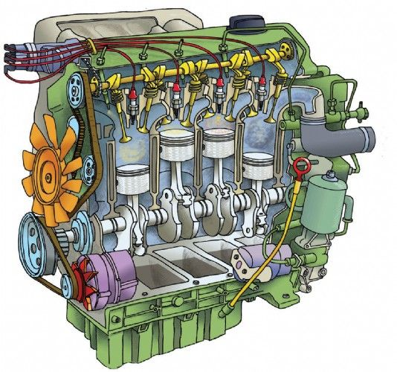
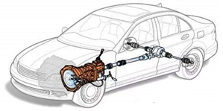
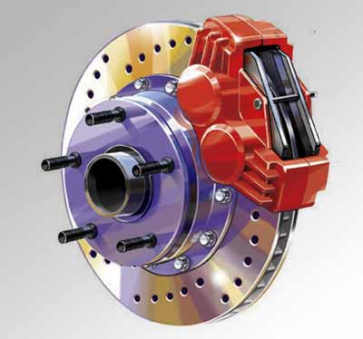
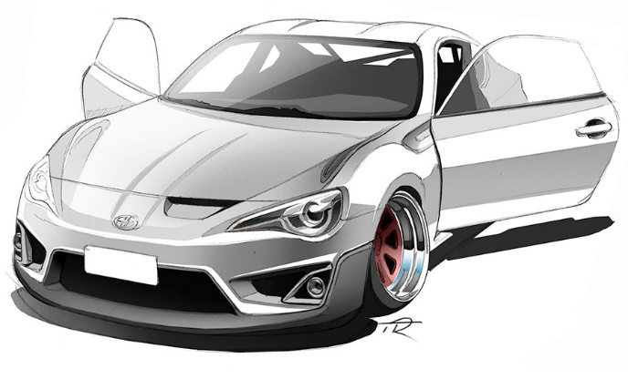

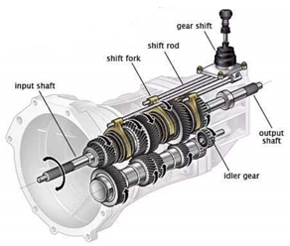
Types of tests
Unit testing
Integration testing
Usability testing/UAT
System testing

Slide 5
Unit Testing
Unit test – tests of an individual method, class, or component before it is integrated with other software
Integration Testing
Integration test – tests of the behavior of a group of methods, classes, or components

Slide 6
System, Performance, and Stress Testing (1 of 2)
System test – an integration test of an entire system or independent subsystem
Can be performed at the end of each iteration
Can be performed more frequently
Build and smoke test – a system test that is performed daily or several times a week
The system is completely compiled and linked (built), and a battery of tests is executed to see whether anything malfunctions in an obvious way (“smokes”)
Automated testing tools are used. Catches any problems that may have come up since the last system test

Slide 7
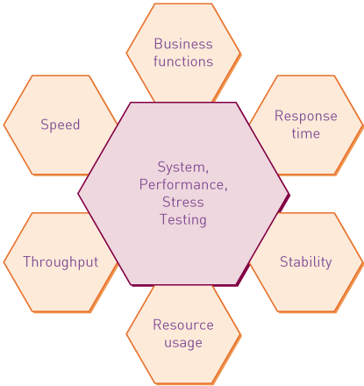
System, Performance, and Stress Testing (2 of 2)
Performance test or stress test – an integration and usability test that determines whether a system or subsystem can meet time-based performance criteria
Response time – the desired or maximum allowable time limit for software response to a query or update
Throughput – the desired or minimum number of queries and transactions that must be processed per minute or hour

Slide 8
User Acceptance Testing (U A T)
User acceptance test
a system test performed to determine whether the system fulfills user requirements
May be performed near the end of the project (or at end of later project iterations)
A very formal activity in most development projects. Payments tied to passing tests
Details of acceptance tests are sometimes included in the request for proposal (R F P) and procurement contract

